Slide 1

TERRAFORM BASICS
“INFRASTRUCTURE AS CODE”
September 2024

Slide 2

TOPICS
What is Terraform?
How does Terraform work?
Manage any infrastructure
Track your infrastructure
Automate changes
Standardize configurations
Collaborate
Terraform graph
Basic commands
Code examples

Slide 3
What is Terraform?
HashiCorp Terraform is an infrastructure as code tool that lets you define both cloud and on-prem resources in human-readable configuration files that you can version, reuse, and share.
You can then use a consistent workflow to provision and manage all of your infrastructure throughout its lifecycle.
Terraform can manage low-level components like compute, storage, and networking resources, as well as high-level components like DNS entries and SaaS features.

Slide 4
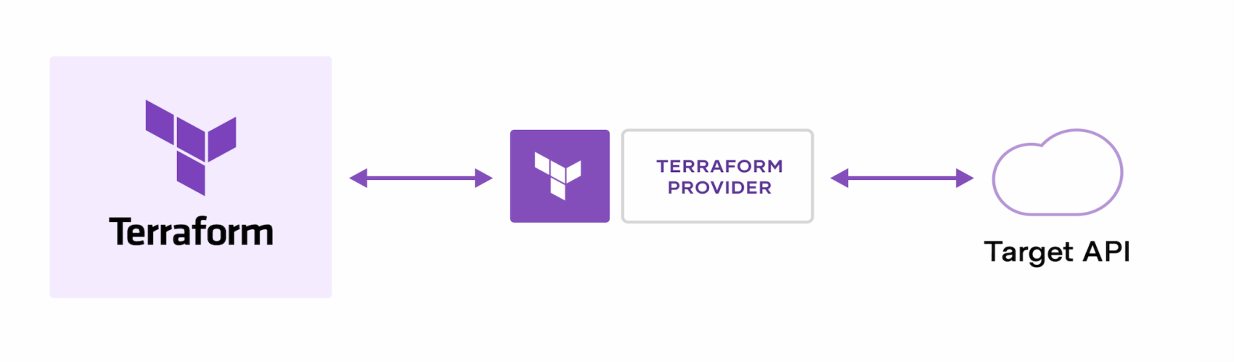
How does Terraform work?
Terraform creates and manages resources on cloud platforms and other services through their application programming interfaces (APIs)
Providers enable Terraform to work with virtually any platform or service with an accessible API.

Slide 5
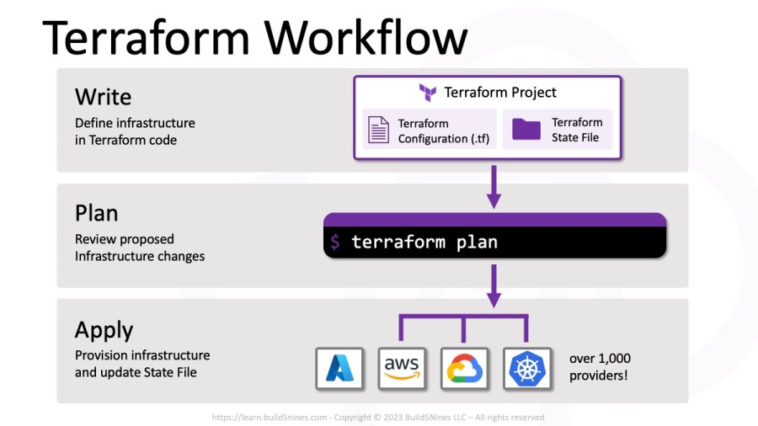
How does Terraform work?

Slide 6
How does Terraform work?
Write: You define resources, which may be across multiple cloud providers and services. For example, you might create a configuration to deploy an application on virtual machines in a Virtual Private Cloud (VPC) network with security groups and a load balancer.
Plan: Terraform creates an execution plan describing the infrastructure it will create, update, or destroy based on the existing infrastructure and your configuration.
Apply: On approval, Terraform performs the proposed operations in the correct order, respecting any resource dependencies. For example, if you update the properties of a VPC and change the number of virtual machines in that VPC, Terraform will recreate the VPC before scaling the virtual machines.

Slide 7
Manage any infrastructure
Find providers for many of the platforms and services you already use in the Terraform Registry.
You can also write your own.
Terraform takes an immutable approach to infrastructure, reducing the complexity of upgrading or modifying your services and infrastructure.

Slide 8
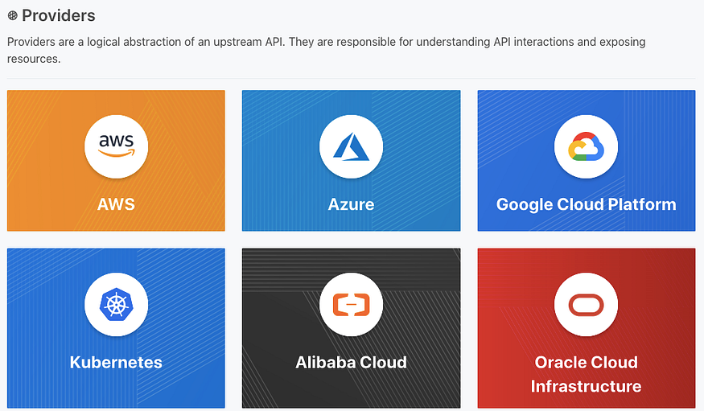
Manage any infrastructure

Slide 9

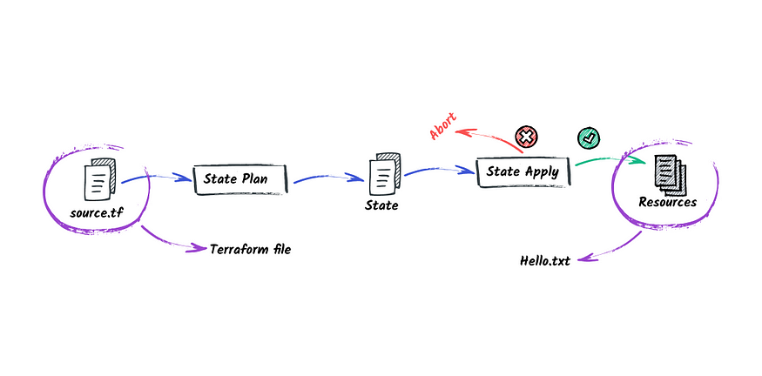
Track your infrastructure
Using bullets with indent button
Use the indent button to create the text levels with the appropriate bullet.
Terraform generates a plan and prompts you for your approval before modifying your infrastructure.
It also keeps track of your real infrastructure in a state file, which acts as a source of truth for your environment.
Terraform uses the state file to determine the changes to make to your infrastructure so that it will match your configuration.

Slide 10
Automate changes
Using bullets with indent button
Use the indent button to create the text levels with the appropriate bullet.
Terraform configuration files are declarative, meaning that they describe the end state of your infrastructure.
You do not need to write step-by-step instructions to create resources because Terraform handles the underlying logic.
Terraform builds a resource graph to determine resource dependencies and creates or modifies non-dependent resources in parallel.
This allows Terraform to provision resources efficiently.

Slide 11
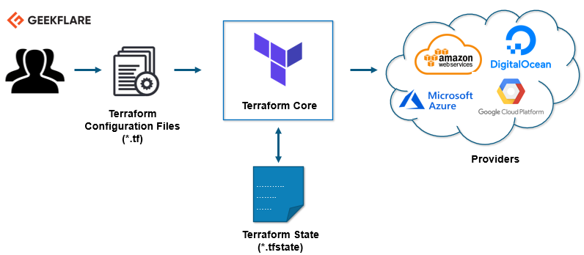
Automate changes
Using bullets with indent button
Use the indent button to create the text levels with the appropriate bullet.

Slide 12
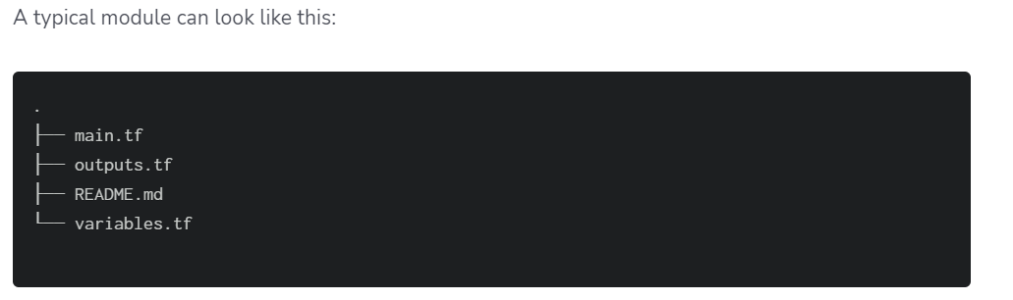
Standardize configurations
Terraform supports reusable configuration components called modules that define configurable collections of infrastructure, saving time and encouraging best practices.
You can use publicly available modules from the Terraform Registry or write your own.

Slide 13

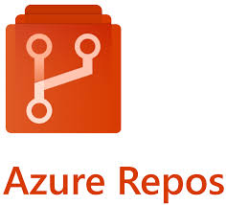
Collaborate
Since your configuration is written in a file, you can commit it to a Version Control System (VCS), for example Git, and use a centralized storage backend to efficiently manage Terraform workflows across multiple users.

Slide 14
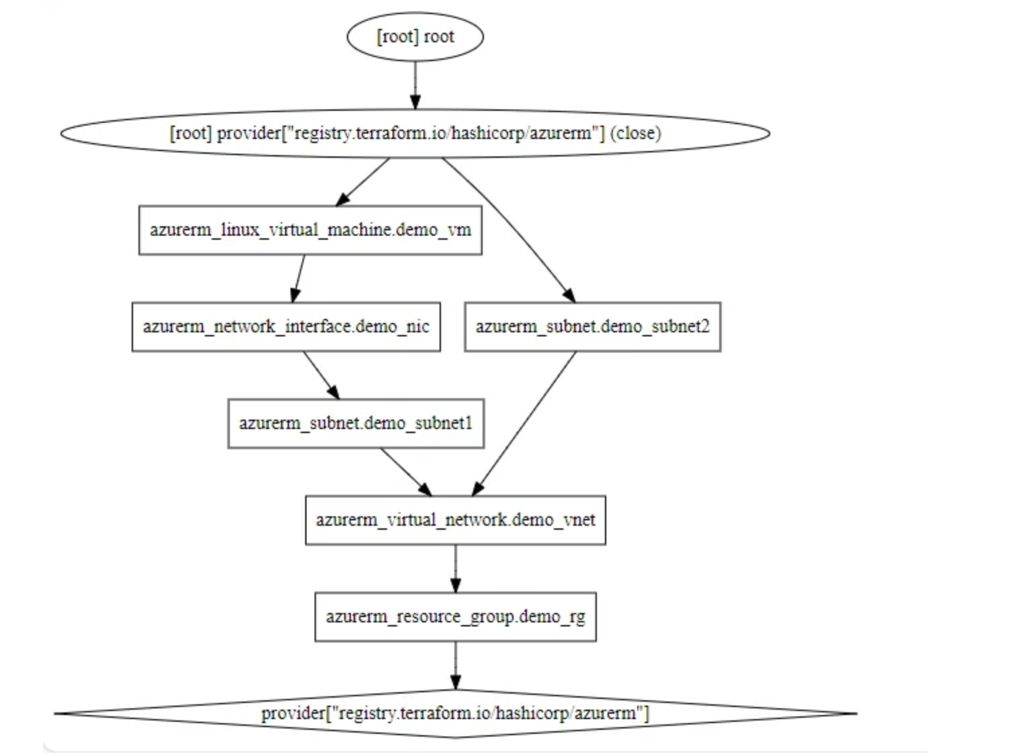
Terraform graph
Terraform graph command generates a visual representation of the dependency relationships between resources in your Terraform configuration or execution plan, helping you to understand the structure and dependencies within your infrastructure.

Slide 15
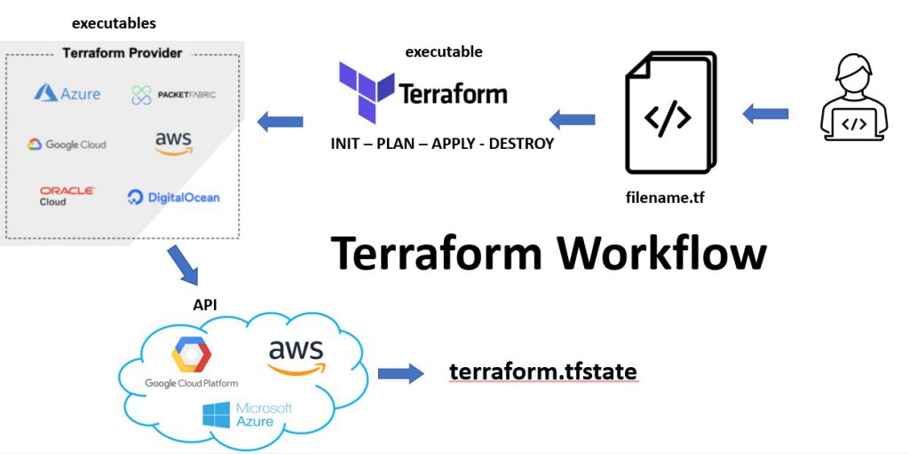
Terraform Workflow

Slide 16
Basic commands
terraform init
terraform plan
terraform apply
terraform destroy
Init performs backend Initialization, child module installation, and plugin installation.
Plan will generate an execution plan, showing you what actions will be taken without actually performing the planned actions.
Apply will create or update infrastructure depending on the configuration files. By default, a plan will be generated first and will need to be approved before it is applied.
Destroy will wipe/destroy the infrastructure managed by Terraform.

Slide 17
Terraform providers code example
terraform {
required_version = ">=0.12"
required_providers {
azapi = {
source = "azure/azapi"
version = "~>1.5"
}
azurerm = {
source = "hashicorp/azurerm"
version = "~>2.0"
}
random = {
source = "hashicorp/random"
version = "~>3.0"
}
}
}
provider "azurerm" {
features {}
}
terraform {
backend "azurerm" {
}
}

Slide 18
Terraform configuration file example create VM in Azure
# Create virtual machine
resource "azurerm_linux_virtual_machine" "my_terraform_vm" {
name = "myVM"
location = azurerm_resource_group.rg.location
resource_group_name = azurerm_resource_group.rg.name
network_interface_ids = [azurerm_network_interface.my_terraform_nic.id]
size = "Standard_DS1_v2"
os_disk {
name = "myOsDisk"
caching = "ReadWrite"
storage_account_type = "Premium_LRS"
}
source_image_reference {
publisher = "Canonical"
offer = "0001-com-ubuntu-server-jammy"
sku = "22_04-lts-gen2"
version = "latest"
}
computer_name = var.hostname
admin_username = var.username
admin_ssh_key {
username = var.username
public_key = azapi_resource_action.ssh_public_key_gen.output.publicKey
}
boot_diagnostics {
storage_account_uri = azurerm_storage_account.my_storage_account.primary_blob_endpoint
}
}

Slide 19
Terraform configuration file example create VM in Amazon cloud
# Get latest Amazon Linux 2 AMI
data "aws_ami" "amazon-linux-2" { most_recent = true owners = ["amazon"] filter { name = "name" values = ["amzn2-ami-hvm*"] } }
# Create the Linux EC2 Web server
resource "aws_instance" "web" { ami = data.aws_ami.amazon-linux-2.id instance_type = var.instance_type key_name = var.instance_key subnet_id = var.subnet_id security_groups = var.security_groups }

Slide 20
Terraform configuration file example create VM in Google cloud
resource "google_service_account" "default" {
account_id = "my-custom-sa"
display_name = "Custom SA for VM Instance"
}
resource "google_compute_instance" "default" {
name = "my-instance"
machine_type = "n2-standard-2"
zone = "us-central1-a"
tags = ["foo", "bar"]
boot_disk {
initialize_params {
image = "debian-cloud/debian-11"
labels = {
my_label = "value"
}
}
}
// Local SSD disk
scratch_disk {
interface = "NVME"
}
network_interface {
network = "default"
access_config {
// Ephemeral public IP
}
}
metadata = {
foo = "bar"
}
metadata_startup_script = "echo hi > /test.txt"
service_account {
# Google recommends custom service accounts that have cloud-platform scope and permissions granted via IAM Roles.
email = google_service_account.default.email
scopes = ["cloud-platform"]
}
}

